Slide 1
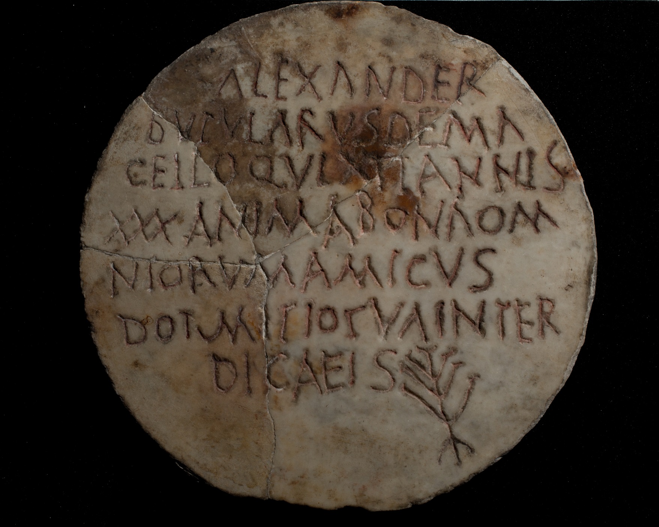
The Ashmolean Latin Inscriptions Project
Notes:
This unusual tombstone was found in a Jewish catacomb (underground tomb-complex) on the Via Appia in Rome. The man’s name, Alexander, is clearly written at the top. At the bottom, there is a rough carving of a menorah, the seven-branched candlestick which is a symbol of Judaism.
The inscription tells us that Alexander worked in the market as a meat-seller. Because there were very strict Jewish laws about how meat must be prepared, it may be the case that he sold ritually-pure meat suitable for Jewish customers.
The inscription reads:
Alexander bubularus de macello qui vixit annis XXX anima bona omniorum amicus dormitio tua inter dicaeis
‘Alexander, beef-seller from the market, who lived thirty years, good soul, friend of all, may your sleep be amongst the just.’
Compare:
4th century gold-glass bowl base with menorah, in the Metropolitan Museum of Fine Art, New York: http://www.metmuseum.org/toah/works-of-art/18.145.1ab
Details:
3rd-4th century AD. Marble, with red painted letters. Diameter 32cm, thickness 8cm. Ashmolean Museum AN2007.51.

