Slide 1
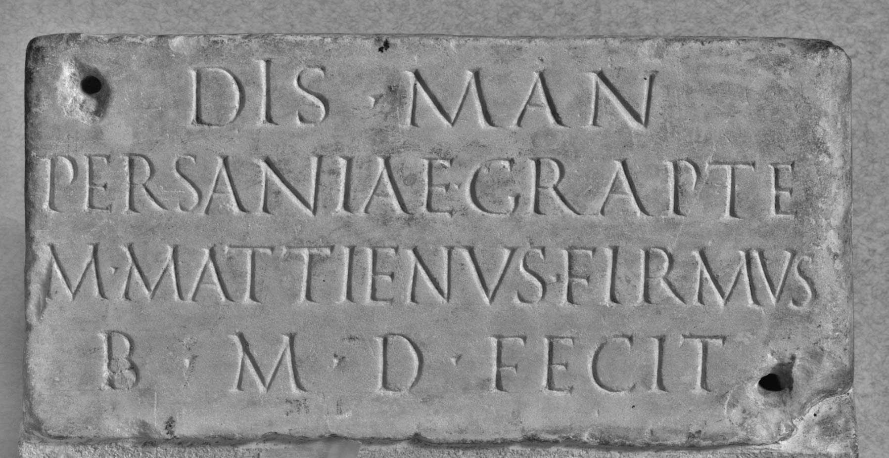
1
The Ashmolean Latin Inscriptions Project

Slide 2
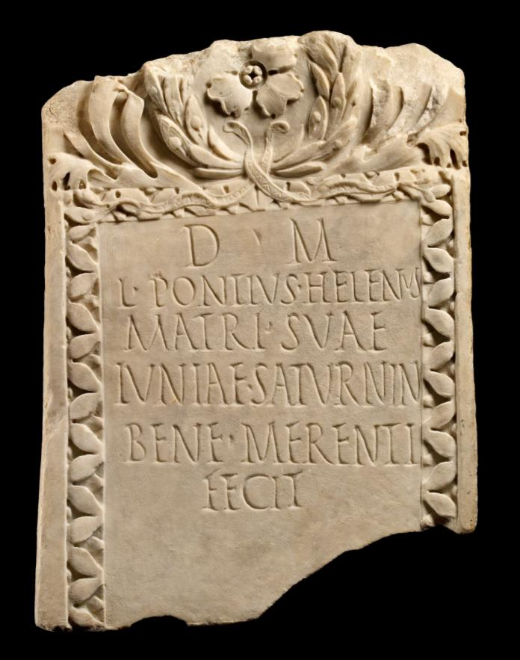
2
The Ashmolean Latin Inscriptions Project

Slide 3
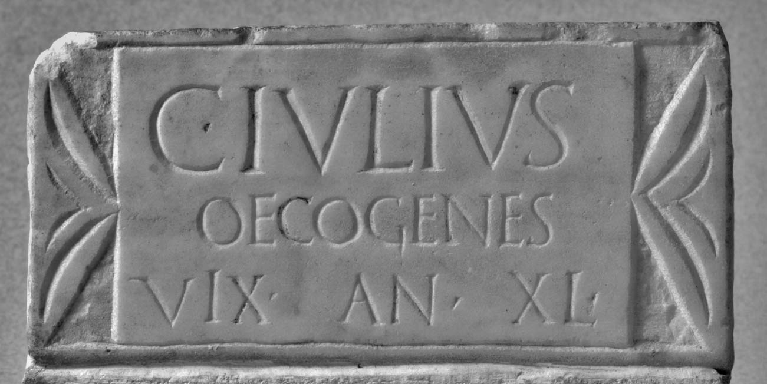
3
The Ashmolean Latin Inscriptions Project

Slide 4
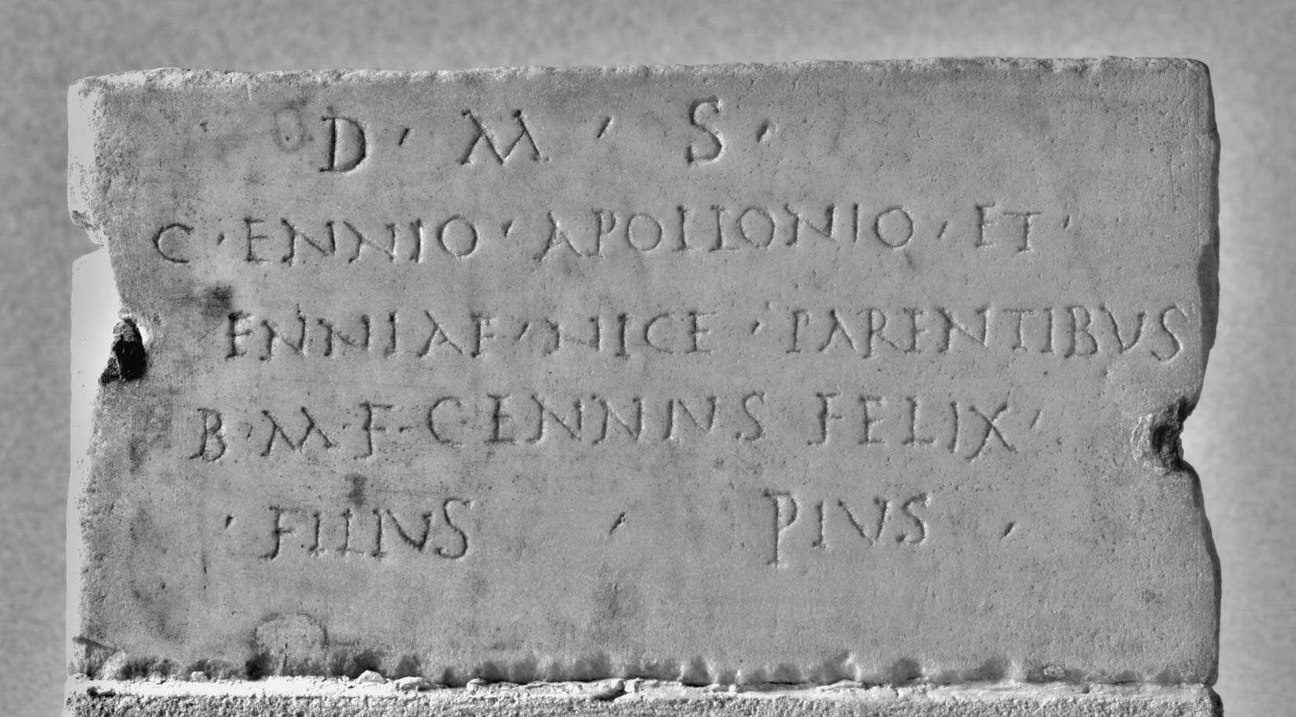
4
The Ashmolean Latin Inscriptions Project

Slide 5
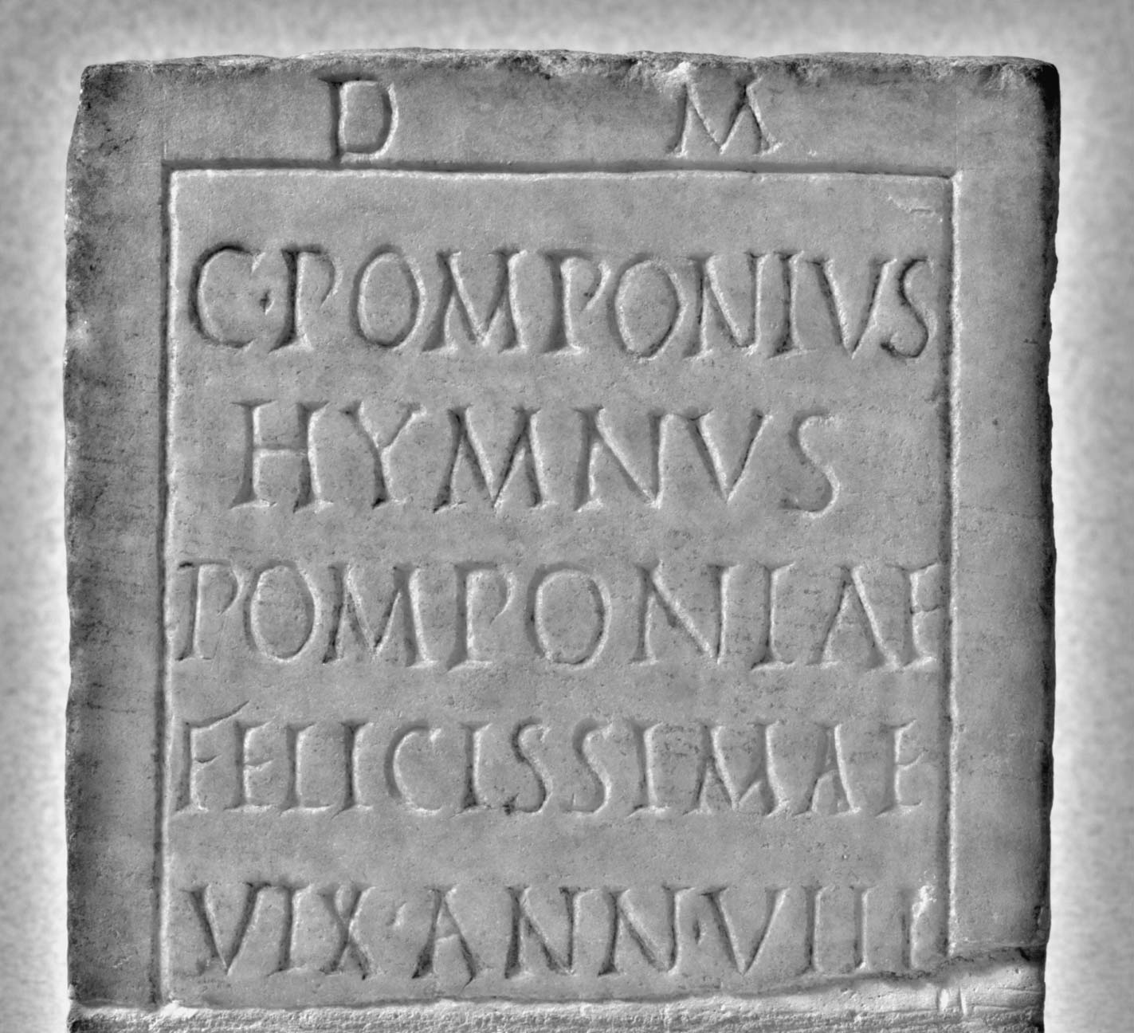
5
The Ashmolean Latin Inscriptions Project

