Slide 1
Writing like Romans
The Ashmolean
Latin Inscriptions Project
latininscriptions.ashmus.ox.ac.uk

Slide 2
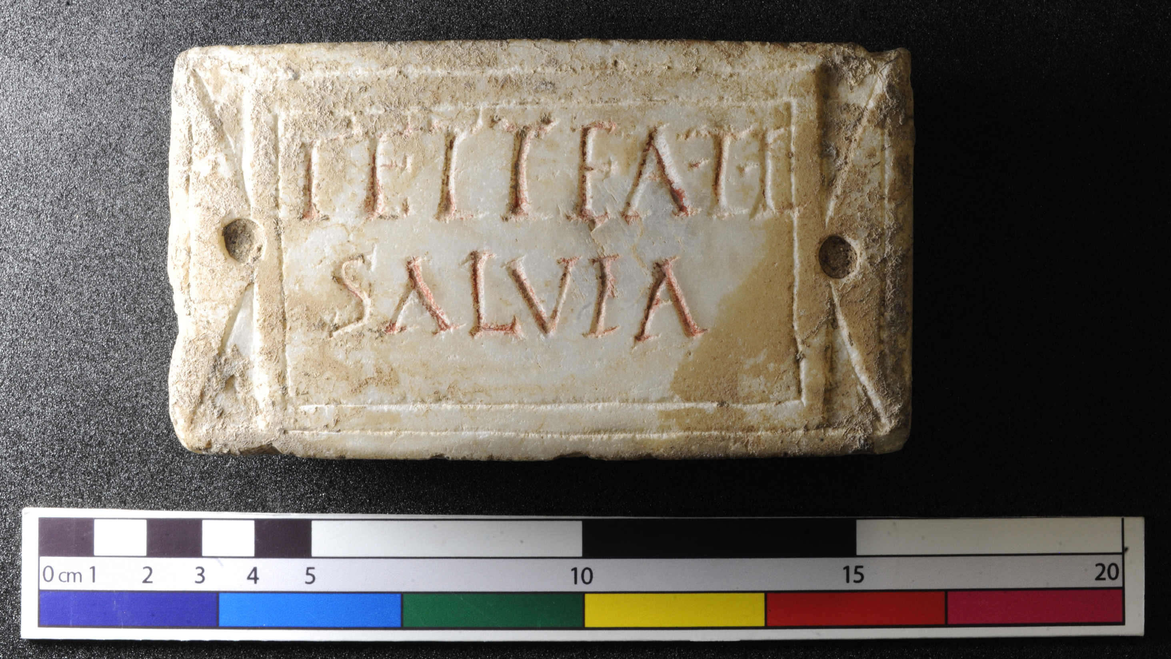
Notes:
We’re going to make Latin inscriptions. Latin is the language the Romans spoke. Inscriptions means writing on something. We’re looking at objects with Roman writing on.
The simplest Latin inscriptions give the person’s name. This one is for Tettea Salvia. Is your name written on any of your things?
Roman names were very important. A proper, Roman sounding name had three names for a man or two for a woman. This told people that you had the full rights of a Roman citizen, like voting (for men only), taking people to court or legal marriage. Slaves took their masters’ name when they were freed so that they could be proper Roman citizens too.
Can you see a faint L at the top right? The L on this inscription lets people know that Tettea Salvia used to be a slave and was freed.
Can you see the red paint in the letters? Why do you think they did this? (It makes it easier to read and looks nicer) Lots of things the Romans made were actually very colourful. Why do you think paint is often lost? (It rubs away when things are buried in the ground or wears off in the wind and rain if they’re above ground. Sometimes someone has “cleaned” them a little too thoroughly.)

Slide 3
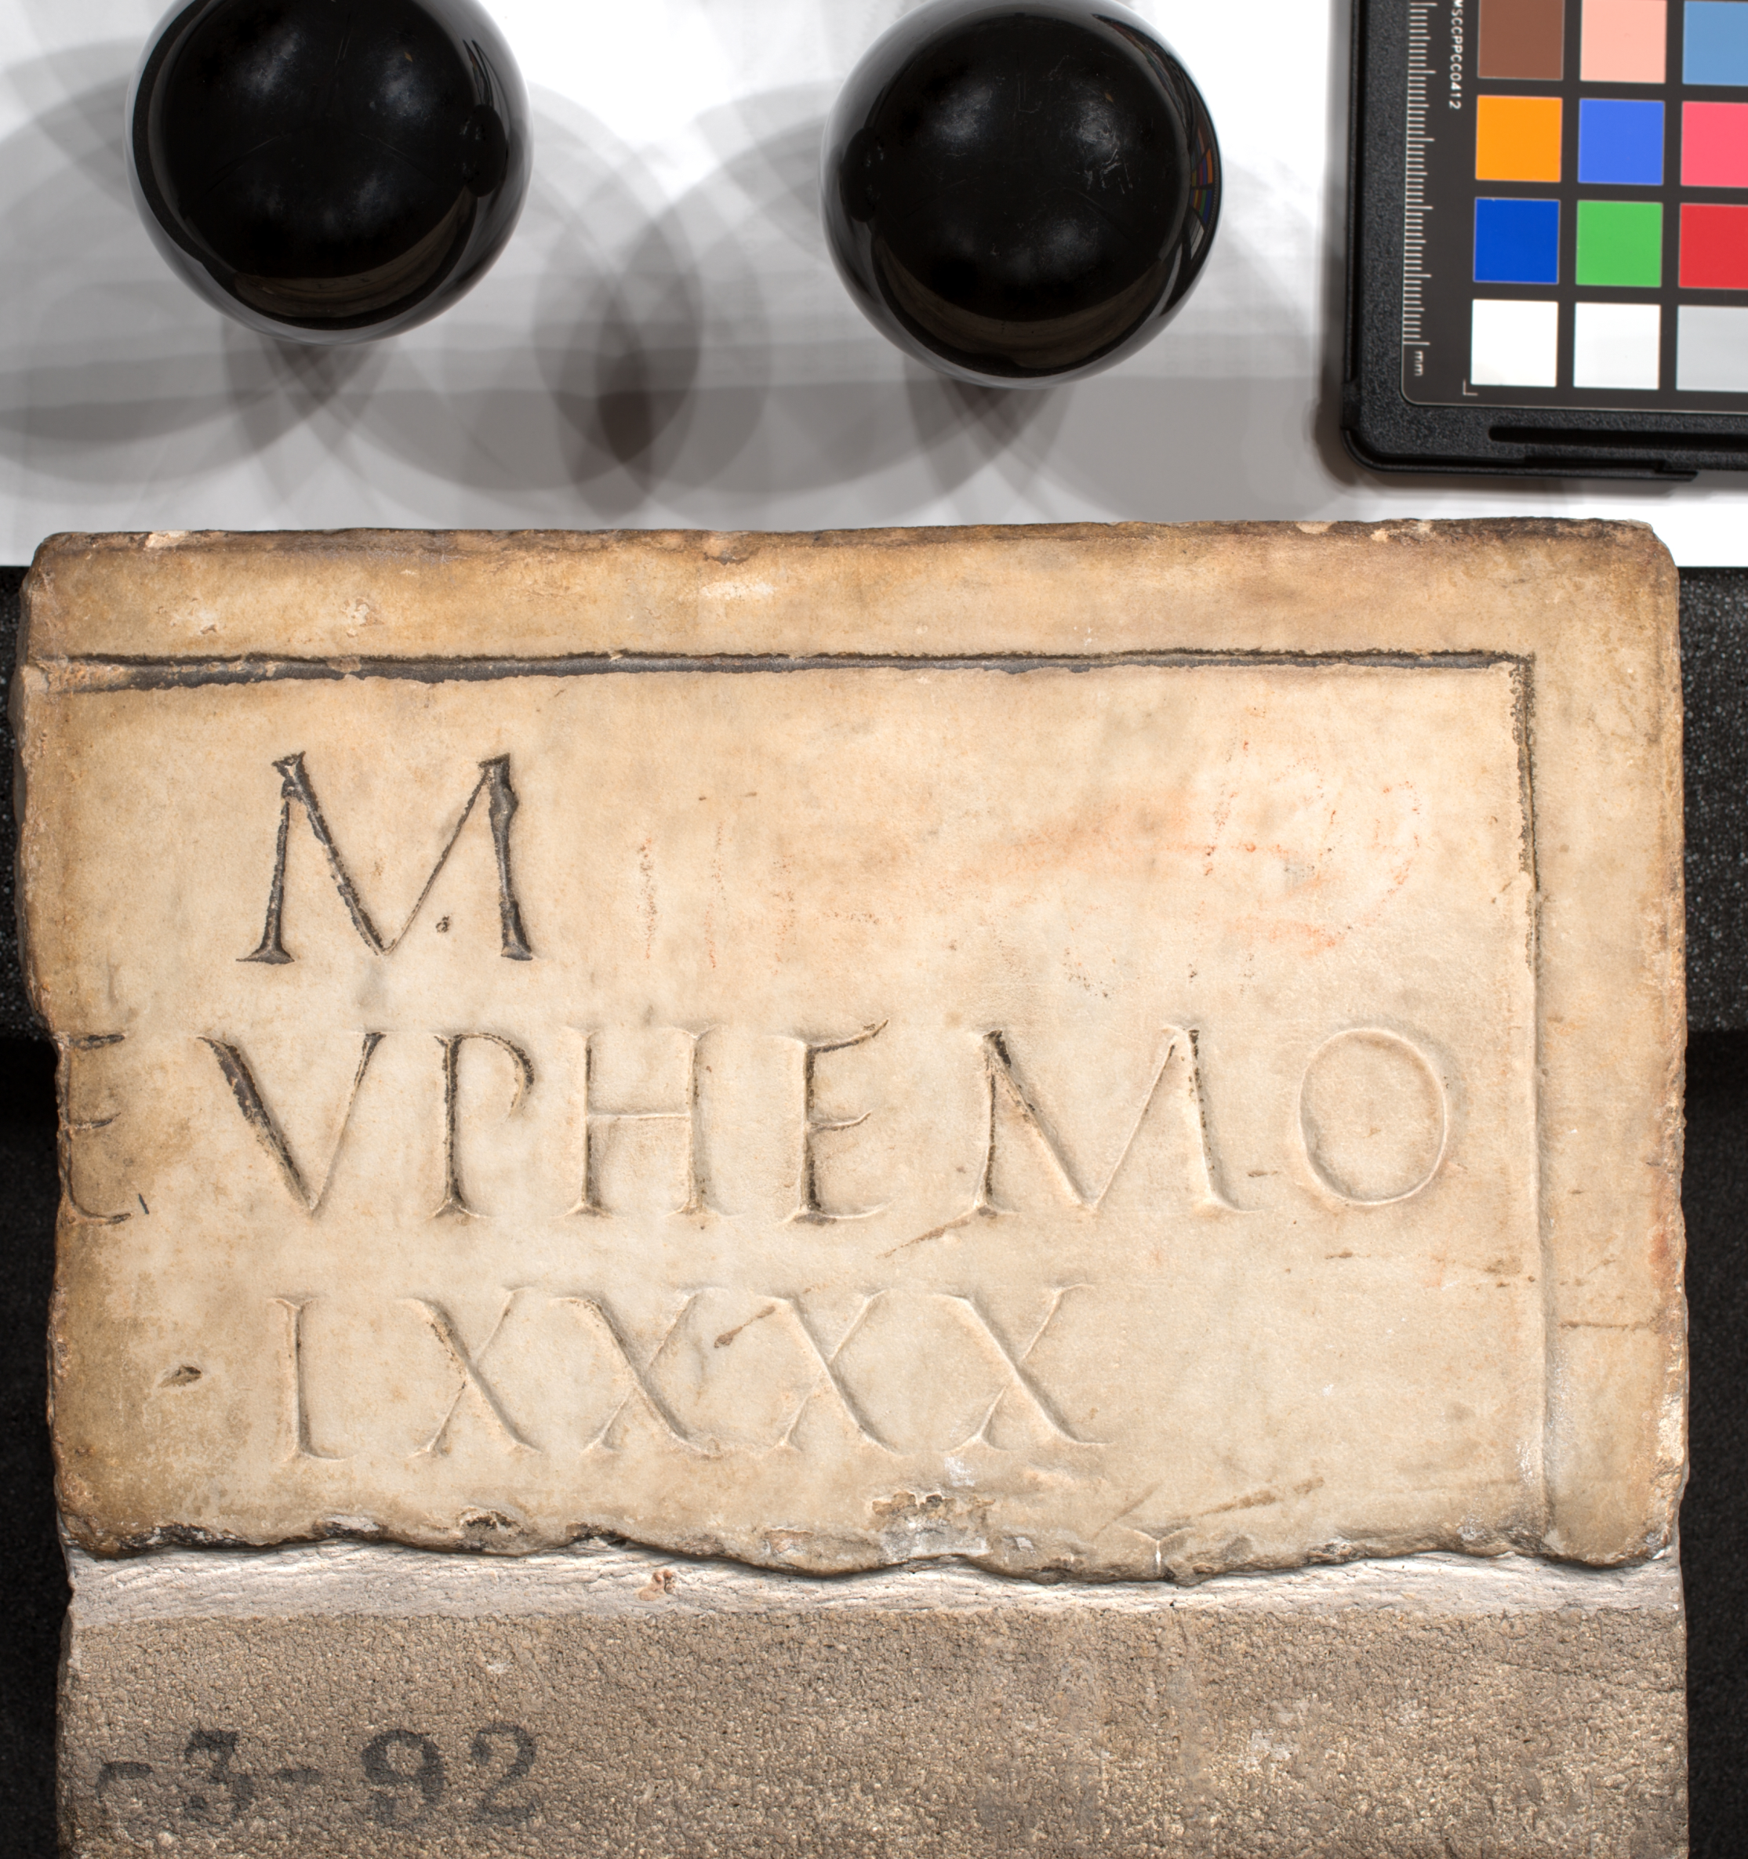
Notes:
Here’s another one with paint still on it. Do you think this is the whole inscription? (no) Why? (there’s half an e on the Left side)
There is a Roman numeral at the bottom. LXXXX. Can you work out what number it is? (90) The owner of this gravestone lived to 90 years old.

Slide 4
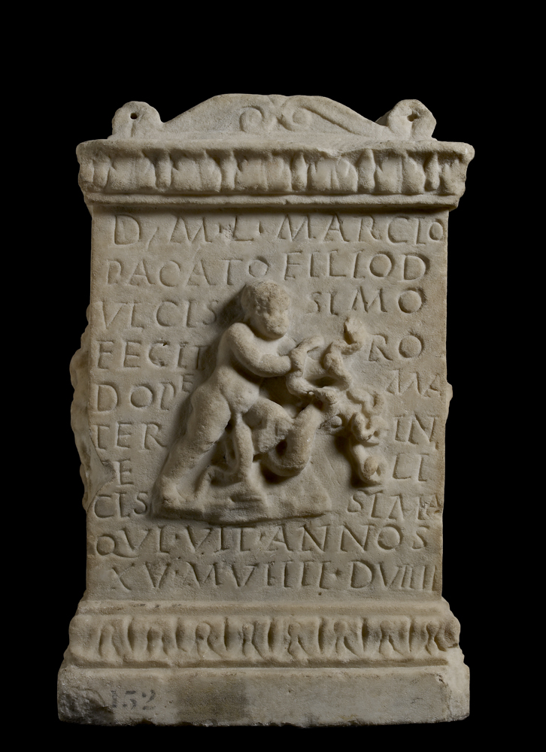
Notes:
Often, inscriptions had to be squeezed around decoration. This inscription shows how words could go over lines. e.g. dulcis (meaning sweet on lines 2-3). Also look at how the stone carver crammed in little letters at the end of the lines (like the tiny A 3rd line from bottom or the little e squeezed in near the baby’s bottom)
Why is a baby fighting snakes? This is the baby hero Hercules, who started his adventures young.

Slide 5
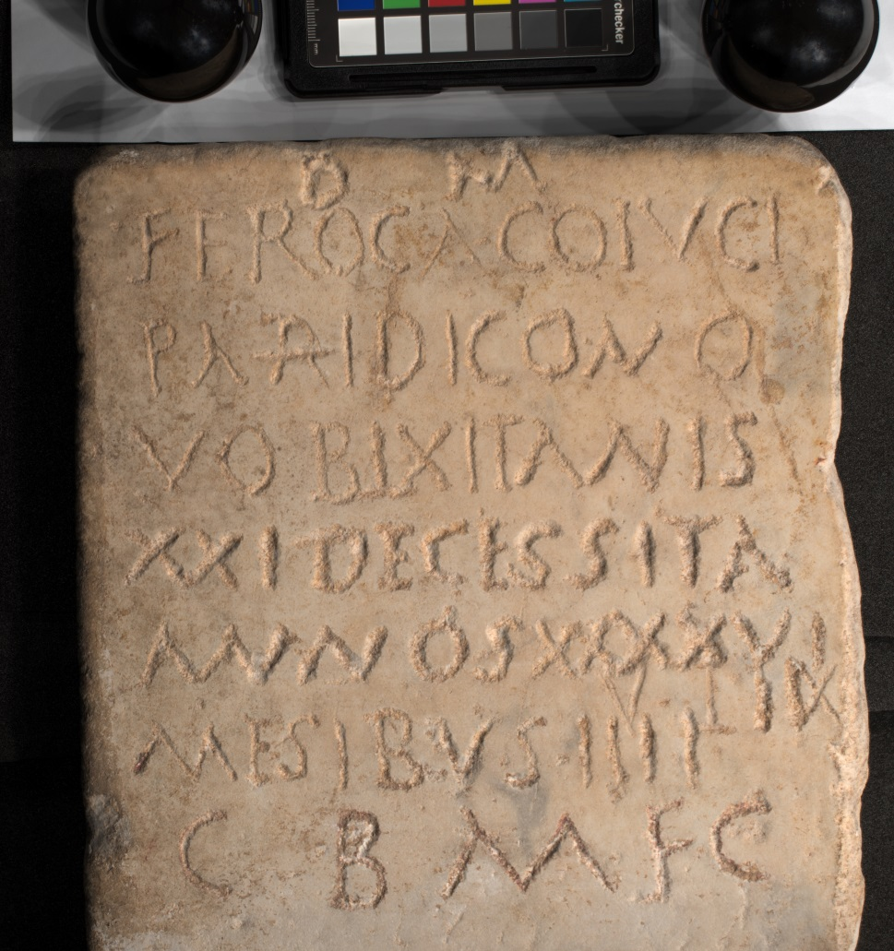
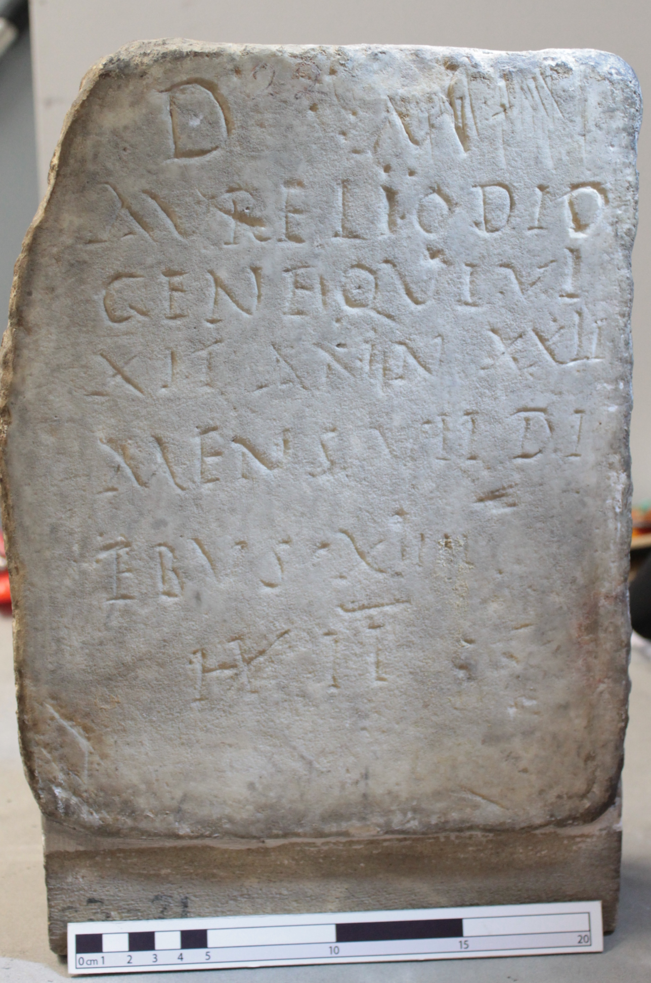
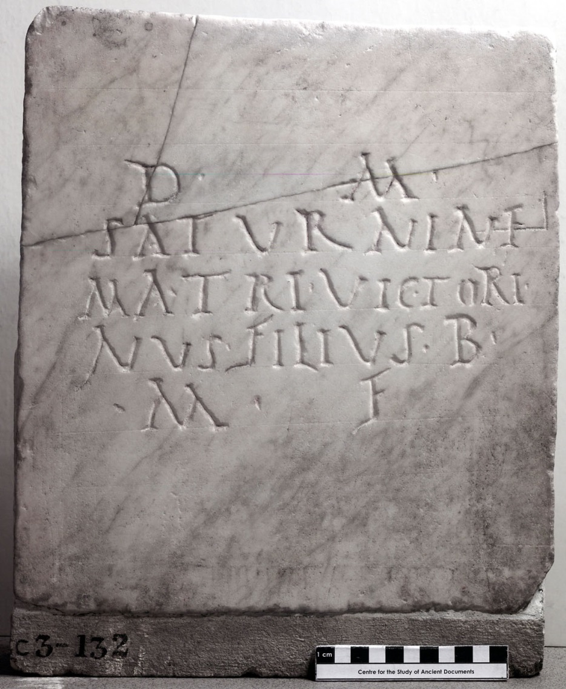
Notes:
Inscriptions weren’t always very tidily written.

Slide 6
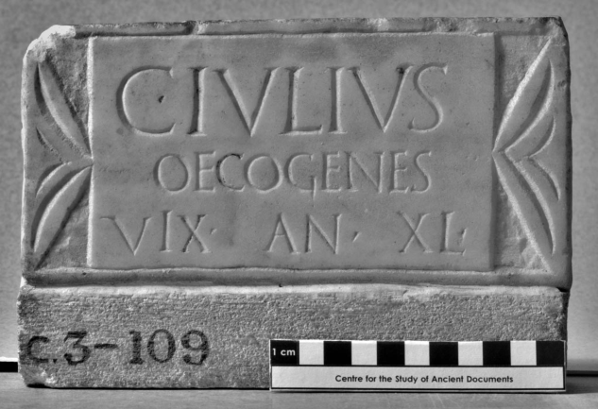
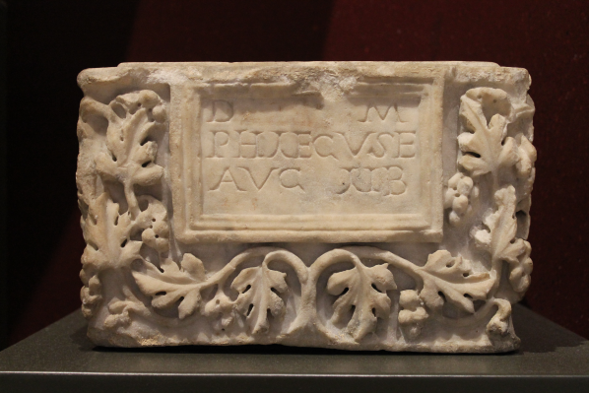
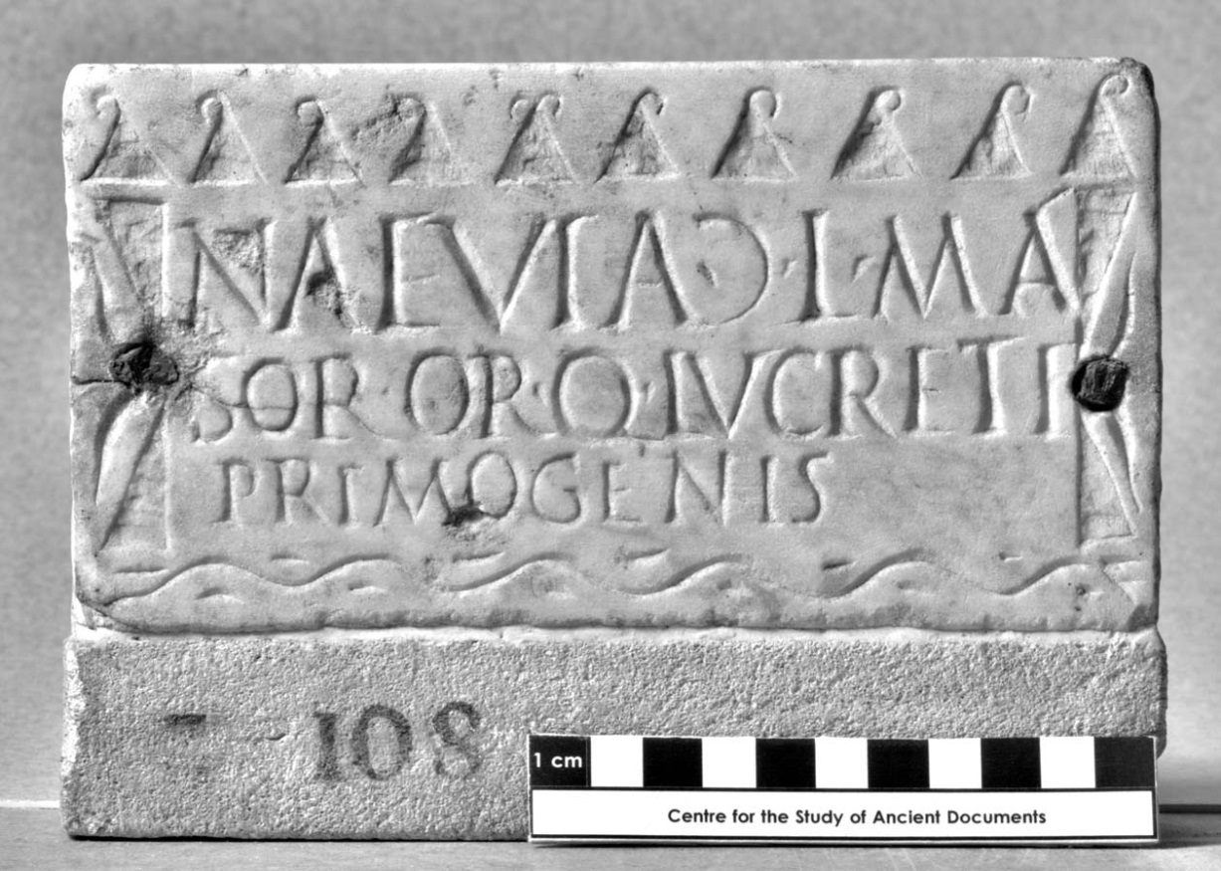
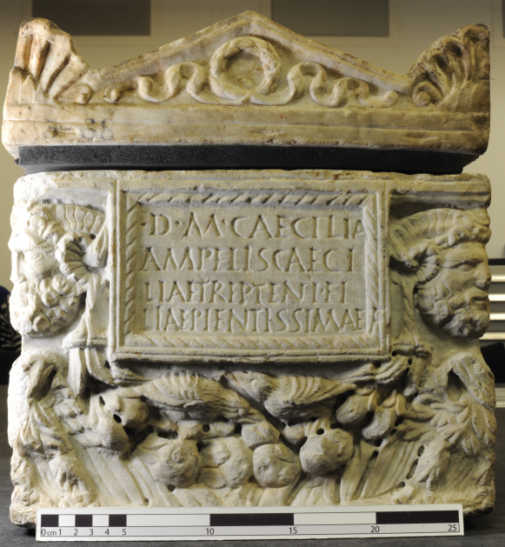
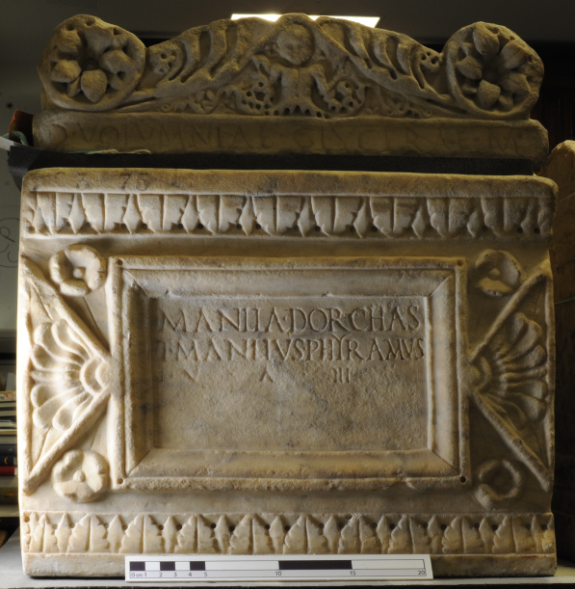
Notes:
Sometimes they have decorated borders. Can you spot grapes? Birds? A wreath? Men with horns? Flowers?

Slide 7
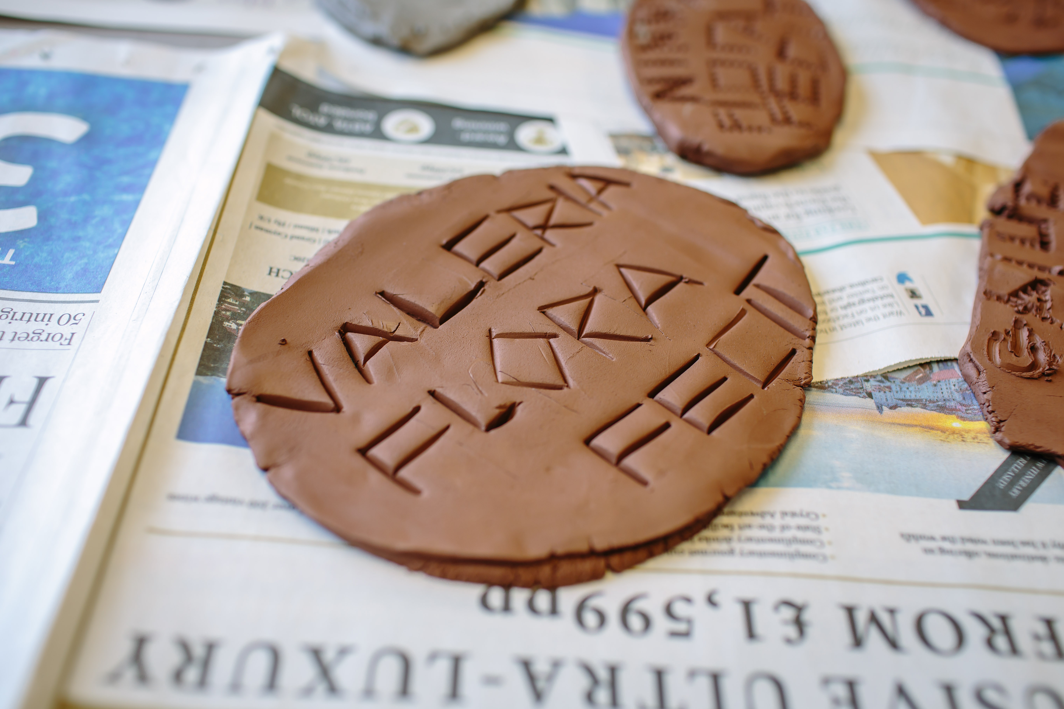
Notes:
We’re going to make an inscription out of clay. Everyone is going to get a Roman name, choose a Roman nickname and then make a clay inscription with that name.
You will get a full Roman name, like an elite Roman citizen. You can choose to be a Roman man or a Roman Woman.
You will write out your full name on clay. Then write “fecit” [pronounced Fay-Kit]. This is a verb that means made this. This makes a full Latin sentence.

Slide 8
Notes:
This slide is in case children have trouble forming letters from straight lines.
They may notice that U seems to be missing. For the Romans, U and V were the same letter, pronounced like a W when it is being a consonant and like the u in “put” when it is a vowel.

