Slide 1
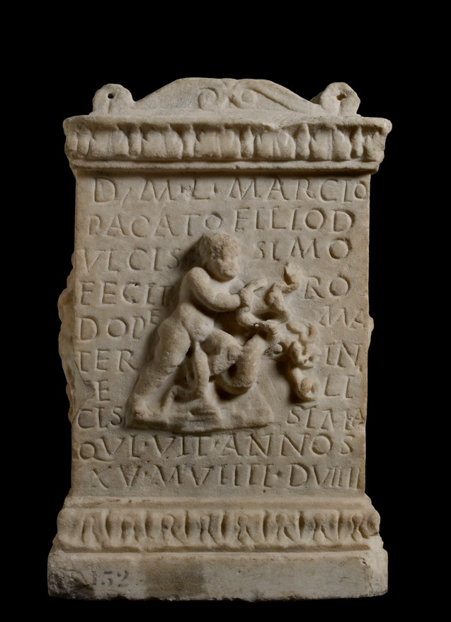
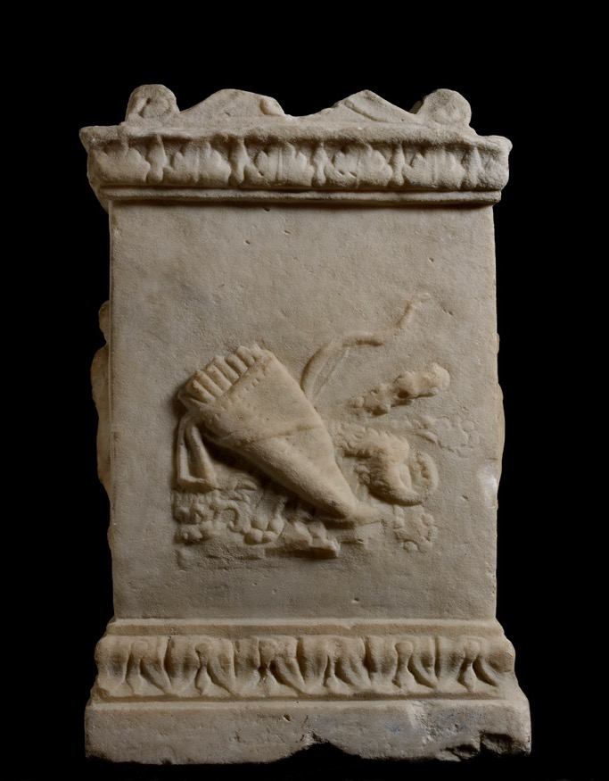
Front
Back
The Ashmolean Latin Inscriptions Project
Notes:
This tombstone is in the shape of a miniature altar and was dedicated to a teenage boy by his mother Rodope (pronounced ‘Rod-OH-pea’). On each side it has relief decoration referring to the myth of Hercules.
The front shows a chubby baby wrestling with the many-headed Hydra. The sculptor has mixed up the story of Hercules strangling snakes when he was a baby, with Hercules killing the snake-like Hydra as an adult.
The back shows Hercules’ possessions: a quiver full of arrows, the Nemean lion’s skin, a bow and a club.
The left side shows a bearded Hercules about to hit a centaur with his club. This is not one of the traditional 12 labours, but shows the story of his fight with Nessus.
The right side shows Hercules about to hit one of the Stymphalian birds with his club. It is more common for Hercules to be shown shooting the birds with his bow, but this image may have been chosen to balance the left side.
The inscription reads:
‘To the spirits of the dead. Rodope, unhappiest mother did this for Lucius Marcius Pacatus, sweetest son, who lived 15 years, 9 months, 9 days.’
In the bottom two lines, the stonecutter has made a mistake. Instead of writing VIX. ANNOS (for ‘vixit annos’ - he lived for … years’), he’s written VIT. ANNOS. Even the Romans made spelling mistakes! You can learn more about how the Romans recorded people’s ages on tombstones in the worksheet Roman Numerals on Roman Tombstones.

Slide 2
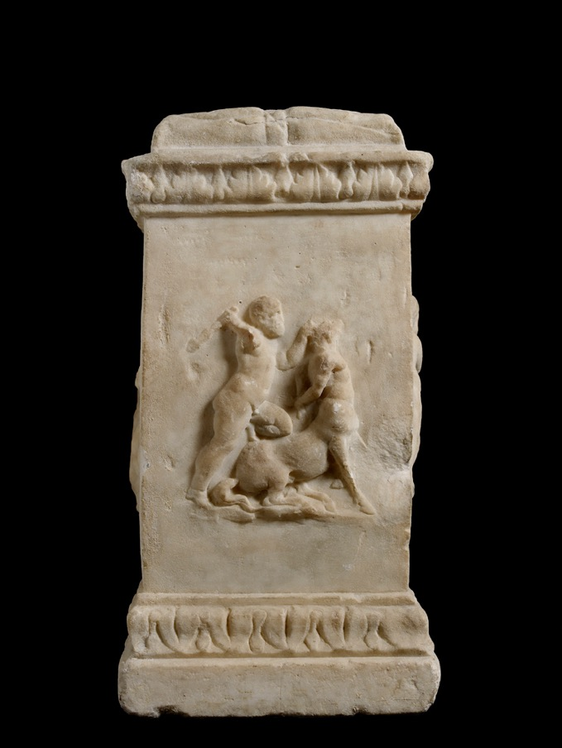
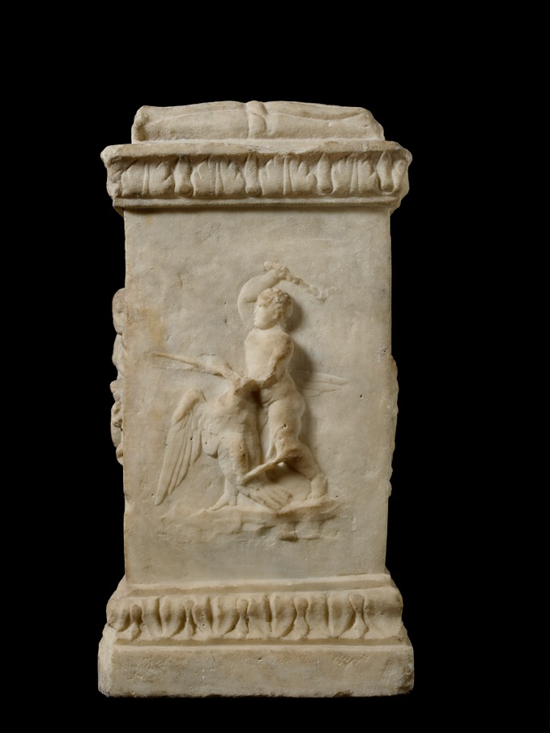
Left
Right
The Ashmolean Latin Inscriptions Project
Notes:
Compare:
The reliefs (metopes) from the Temple of Zeus at Olympia in Greece. These were very famous (and much older than this little altar - they dated from c. 460 BC). There are some useful colour reconstructions of the twelve reliefs here: http://www.hellenicaworld.com/Greece/Art/Ancient/en/HerculesOlympia.html
The tombstone of the one year-old Macrinius (AshLI Slides 1 – Child Horseman), for another image of a young person being commemorated with heroic activities they were too young to take part in.
The statue of Hercules and the centaur Nessus, made in 1599, by the Renaissance sculptor Giambologna.
Details:
Ashmolean Museum ANChandler.3.9. Marble. H. 42cm, W. 27cm, D. 21cm

