Slide 1
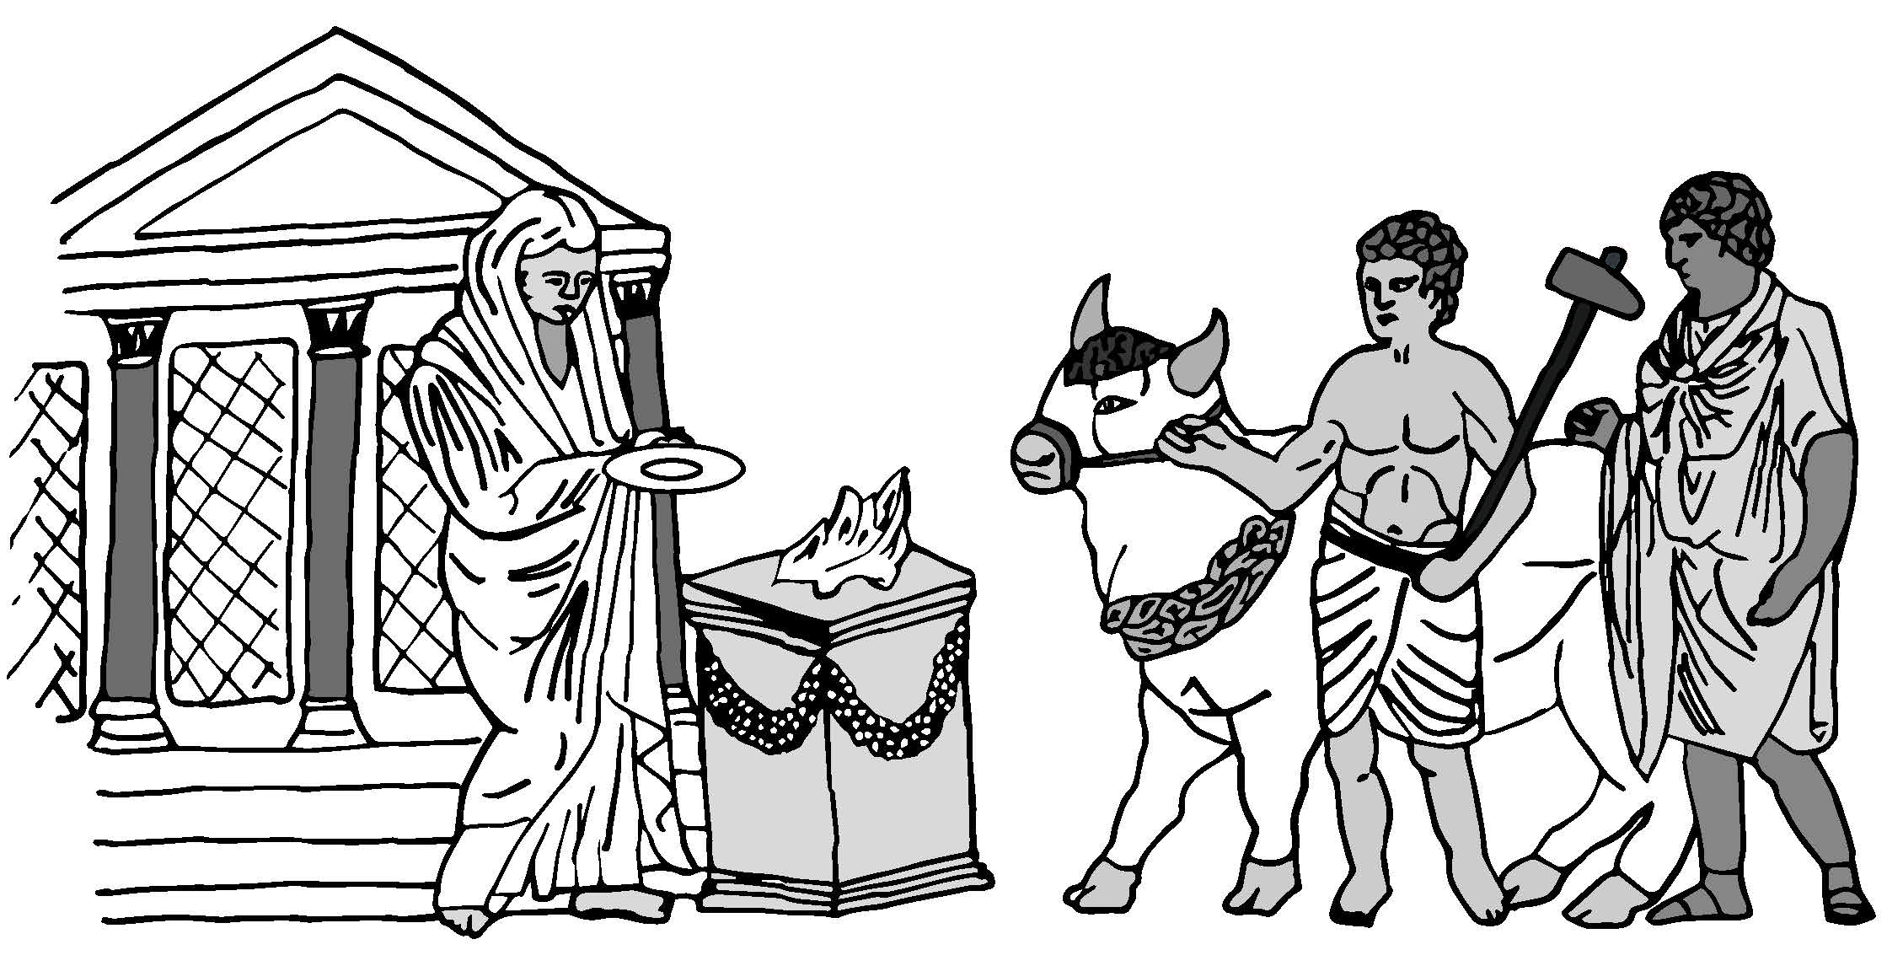
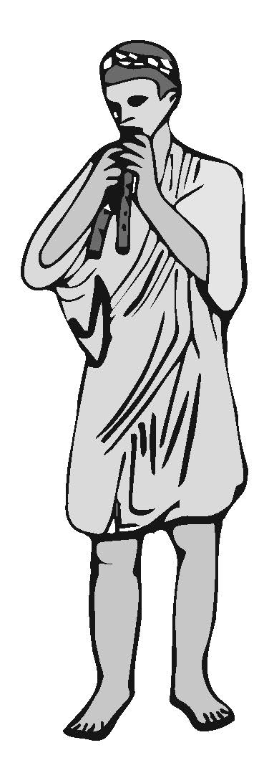
The man who was going to kill the animal wore a belted skirt.
Priests covered their heads with the fabric of their toga.
His axe had a blunt side for stunning the animal and a sharp side for killing it.
The animals were decorated with wreaths of leaves and ribbons.
An animal sacrifice started with a procession.
The animal was brought towards the altar.
Sacrifices were made outside temples in the open air.
A fire was lit on top of the altar, ready to burn the meat from the sacrifice, and send it up to the gods as smoke.
Pipers played music to cover any “unlucky noise” that could ruin a sacrifice.
Offerings of water and wine, called libations, were poured onto the altar from small dishes.

Slide 2
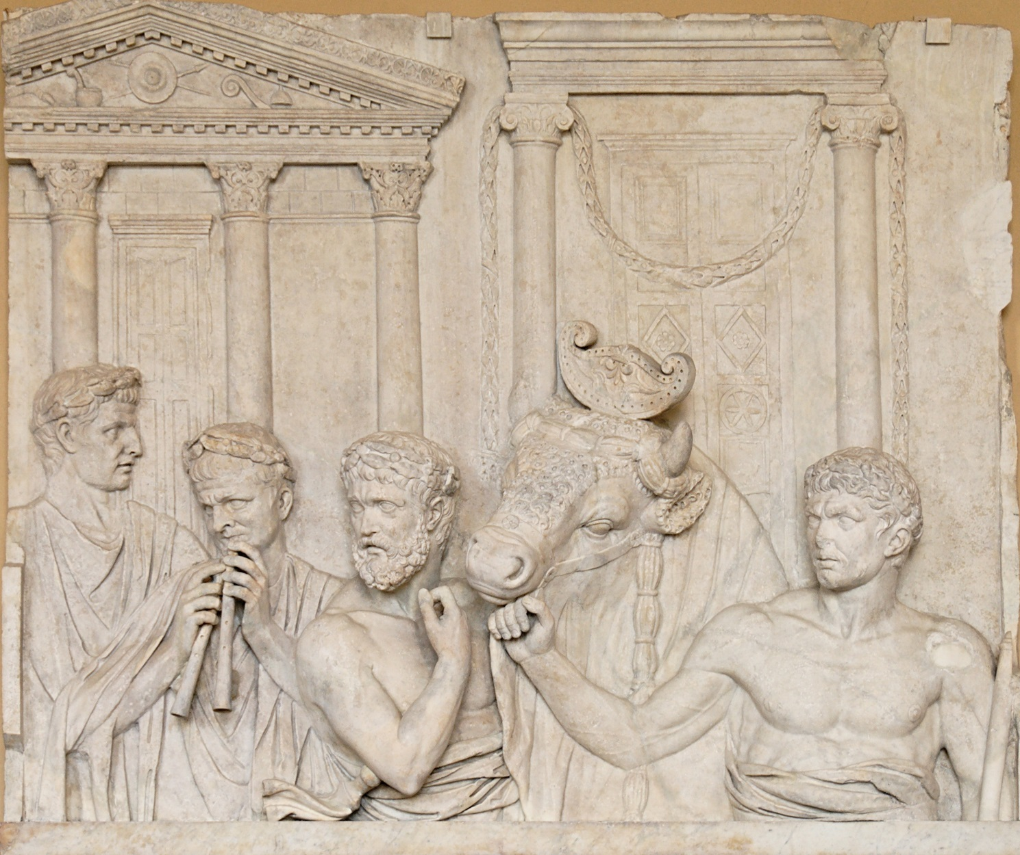
Romans bringing an ox to sacrifice
Notes:
Photo © Jastrow 2007

Slide 3
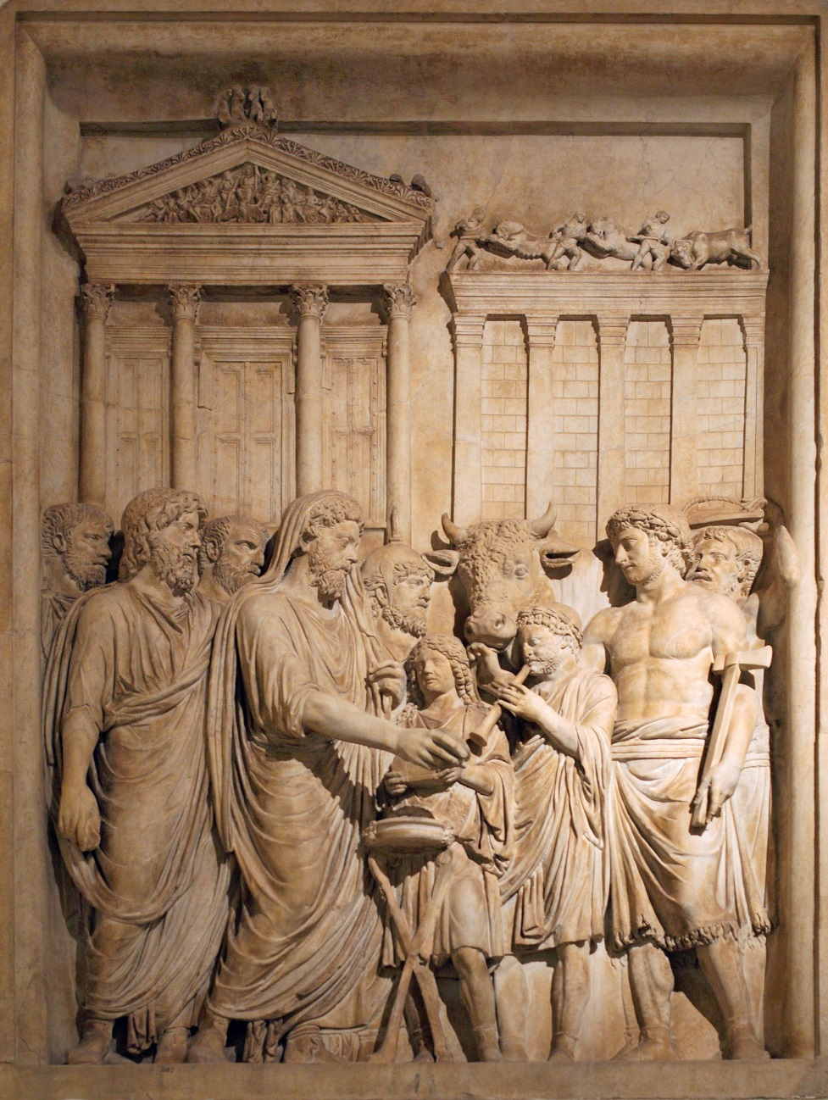
The Emperor, Marcus Aurelius, making a sacrifice
Notes:
Photo © Mattias Kabel 2009

Slide 4
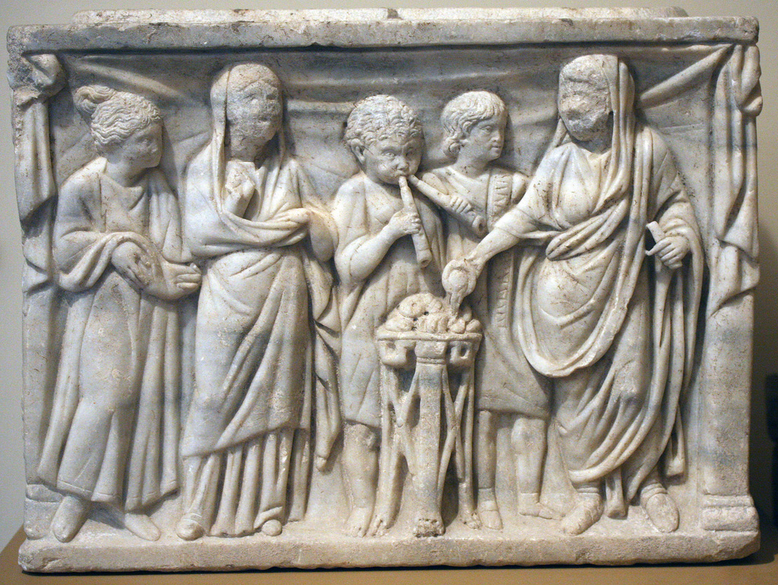
A Roman family sacrificing food and drink

Slide 5
Drum-shaped altar from Roman Delos
Ribbons
Ox heads
Garlands of
fruit and leaves

Slide 6
Red sandstone altar from Roman Chester
On the top,
a dish shape for
burning offerings
Faded inscription to Jupiter
On one side,
a libation jug
On the back,
a libation dish

